Slide 1
Effect of Educational Attainment on per Capita Growth by State
Vicky, Adrianna, Jared, Liliya, Yousief

Slide 2
Selection of Topic
We have taken on the challenge to dissect the impact education has on per capita growth year over year on state level. The goal of our proposed question is to identify trends by state, region and/or education.
Collectively we hope to identify the indicators of monetary impact by educational attainment by state.

Slide 3
Proposed questions to answer with the analysis:
The impact education has on per capita growth year over year in each state
Will there be notable patterns
Are there patterns between states
Are there patterns between regions
Are there outliers
If so, which state or education attainment
Data collected for analysis is from 2005 - 2019

Slide 4
Data Source
Per Capita Income by State
Bureau of Economic Analysis: Regional Economic Accounts, Personal Income (State and Local), Annual Personal Income and Employment by State
https://apps.bea.gov/regional/downloadzip.cfm, SAINC5N_ALLAREAS_1998_2020.csv
Educational attainment
Census.gov: American Community Survey, Selected Social Characteristics in the United States,
https://data.census.gov/cedsci/table?q=DP02&g=0100000US%240400000&tid=ACSDP1Y2019.DP02

Slide 5
Data Exploration
Finding Key Features was the first step:
Education Levels:
- Less than 9th grade -9th to 12th grade - High School -Some College
-Associate’s Degree -Bachelor’s Degree - Graduate Degree
Dependent Variable/Target
-Per Capita Income

Slide 6
Data Exploration DRAFT
Pulling all data deemed necessary to CSV file
-API pull of data to csv file
Preprocessing in Jupyter Notebook:
-Removing columns and rows deemed unnecessary in order to read data.
- Converting objects to strings
-Plotting data to help determine the trends or patterns to dive in deeper
-[Need to do a join]

Slide 7
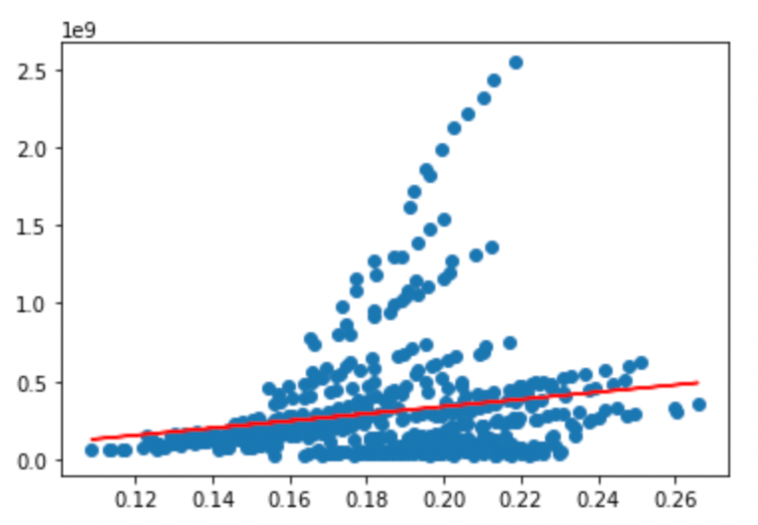
Analysis - Linear Regression
- Creating a line of regression
A positive relationship was observed with some outliers to dissect

Slide 8
Analysis - Machine Learning
Machine Learning
Initially the model was trained using the singular linear regression.
From the linear regression we were able to gather metrics such as r2, coefficients and intercepts which were output to a json file used in Tableau.
-
Continuing working on this portion as we improve and modify our ML model.

Slide 9
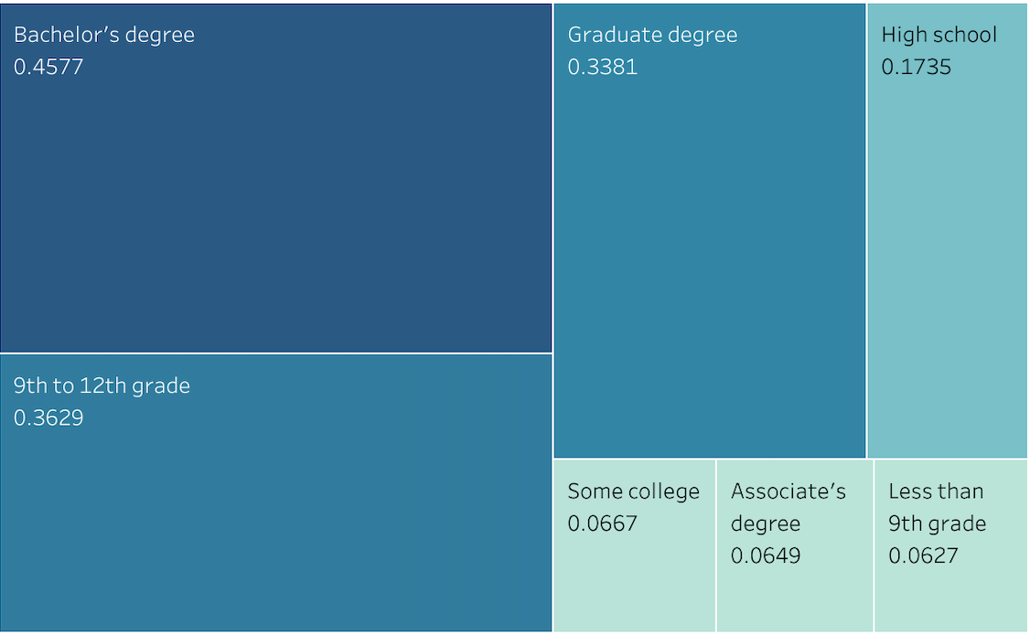
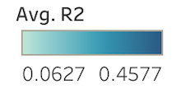
R Squared Indicator

Slide 10
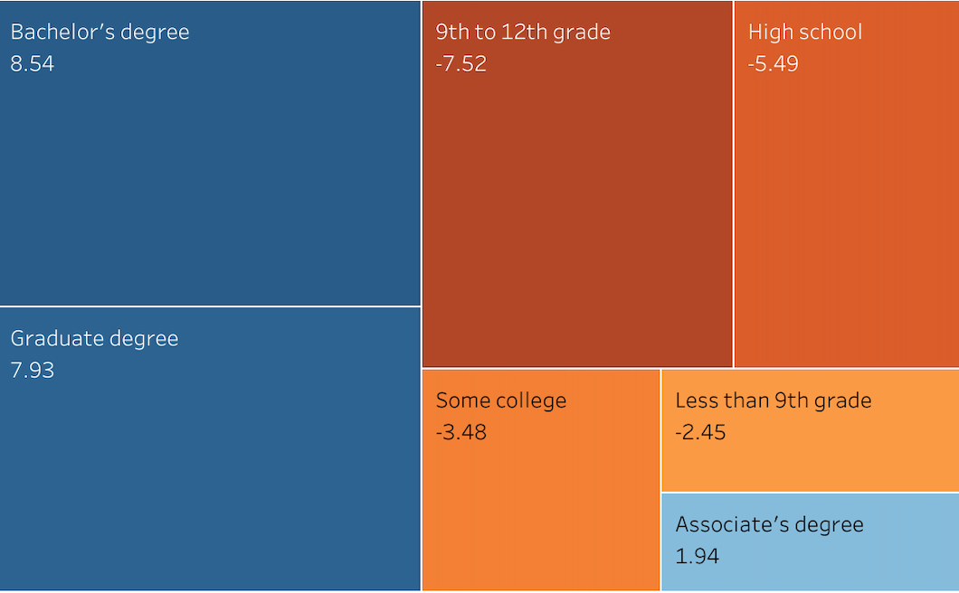
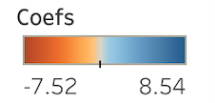
Coefficient Indicator

Slide 11
Analysis Vicky’s Tableau Link
https://public.tableau.com/app/profile/vicky.carlson/viz/EffectofEducationalAttainmentonPerCapitaIncomeGrowth/Story1
See if we can capture the transformation clip and insert into pp
Tableau Visualization
-Heat Map of US
-US Map according to level education
-US Map according to income per capita
-US Map geographic trends

Slide 12
Technologies, Languages, Tools and Libraries
Python 3.7.11
Pandas 1.3.5
Requests 2.26.0
Census Data 1.15
Pathlib 2.3.6
Matplotlib 3.5.0
Sklearn 1.0
Jupyter 1.0
pgAdmin 5.7
PostgreSQL
Tableau Desktop 20.4.2
Tableau Public
Microsoft Excel
Google Drive, Docs, Slides

